Slide 1
Habitat for Humanity at UChicago

Slide 2
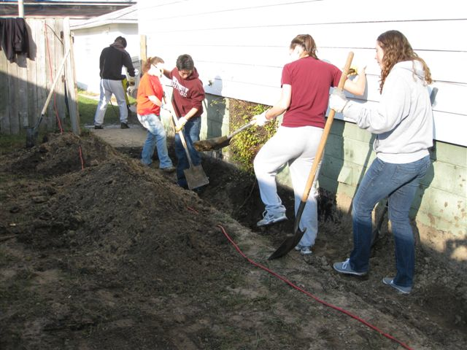
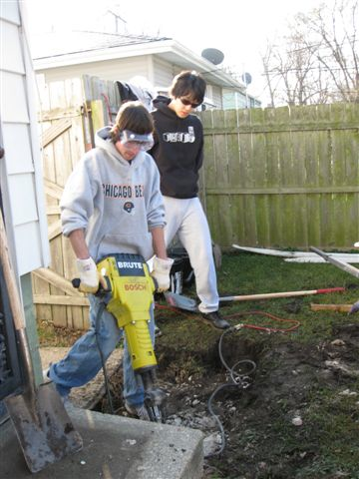
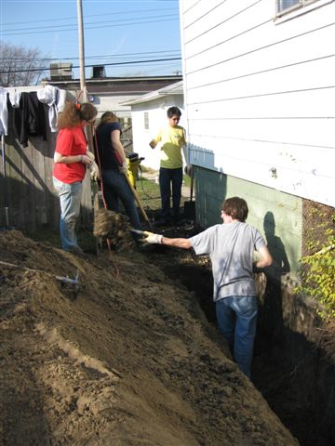
On Any Given Saturday…
What do we do?
Work with HFH Chicago South Suburbs, our affiliate, to renovate and construct homes
Build Trip to the ‘ReStore’ in Gary, IN (2009)

Slide 3
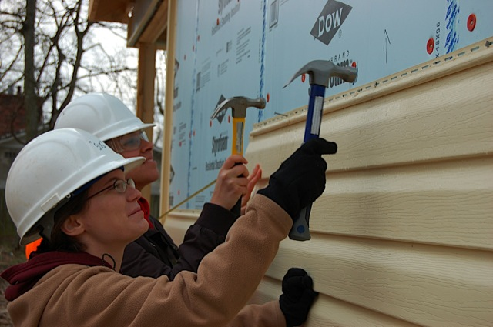
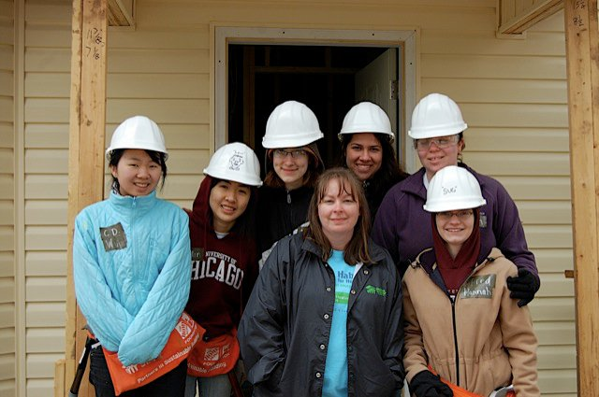
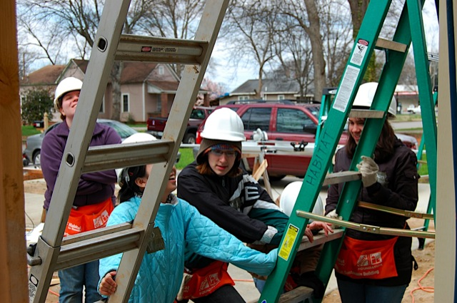
Winter Break and Spring Break Trips
What do we do?
Work for 1 week on home construction
Spend time off exploring the town/city we’re in
Build Trip to Decatur, AL (2010)

Slide 4
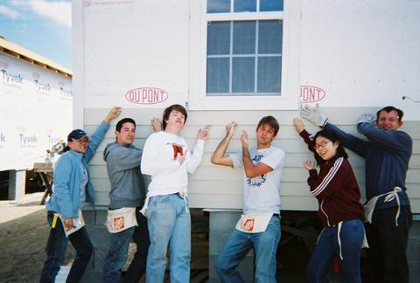
Previous Domestic Trip Locations…
Where have we been?
Aniston, AL
Dade City, FL
Americus, GA
New Orleans, LA
Meridan, MS
Raleigh, NC
Florence, SC
Lynchburg, VA
…and more!
Build Trip to New Orleans, LA (2008)

Slide 5
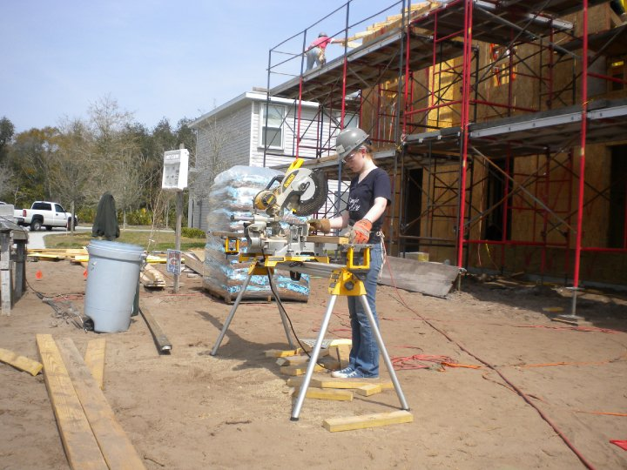
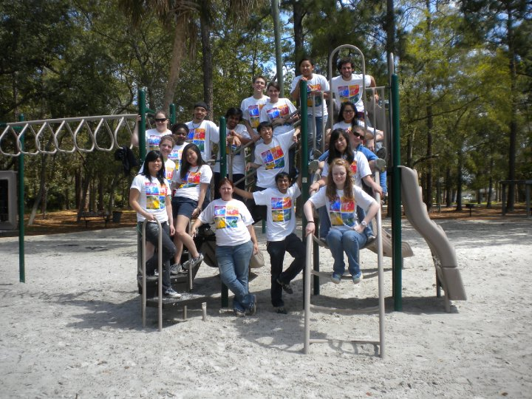
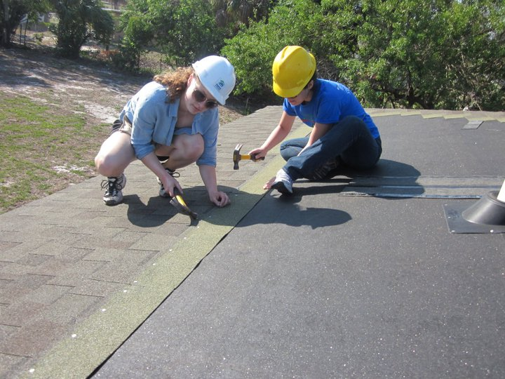
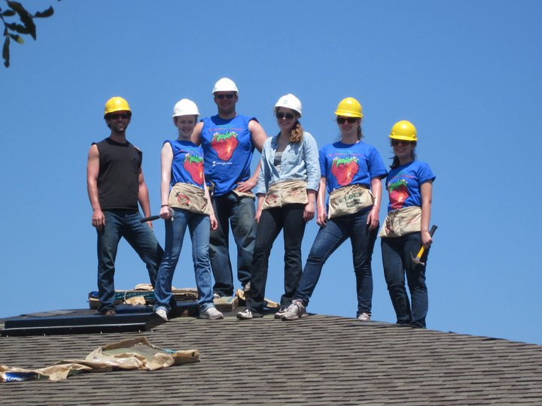
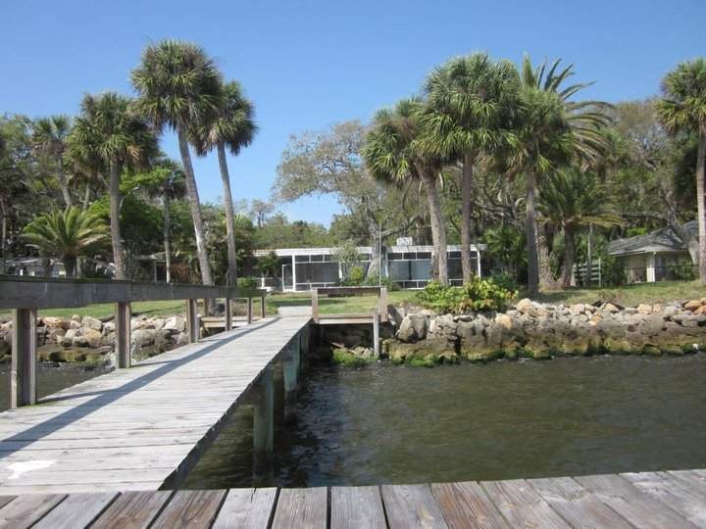

Slide 6
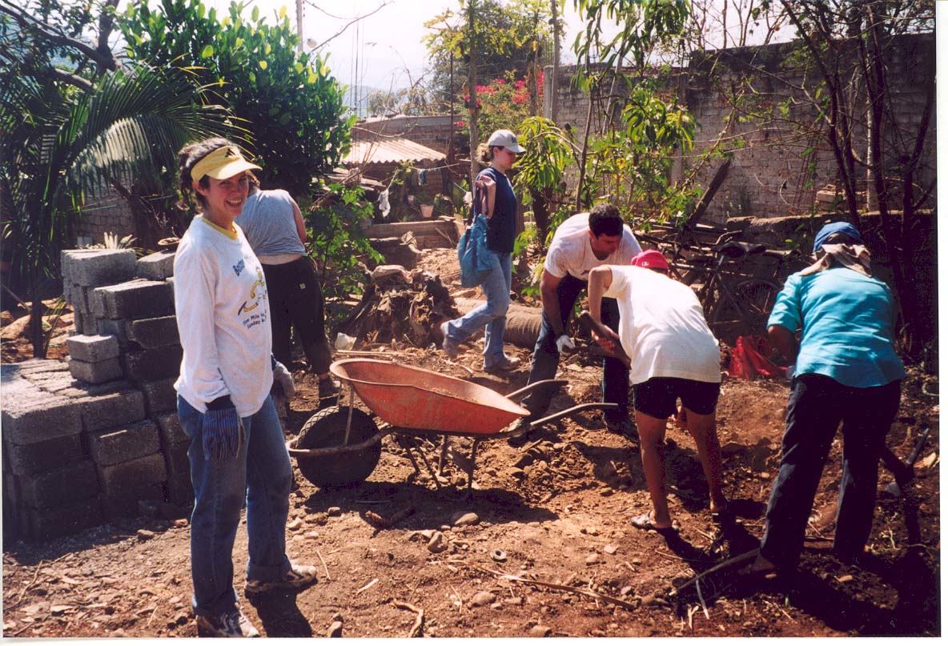
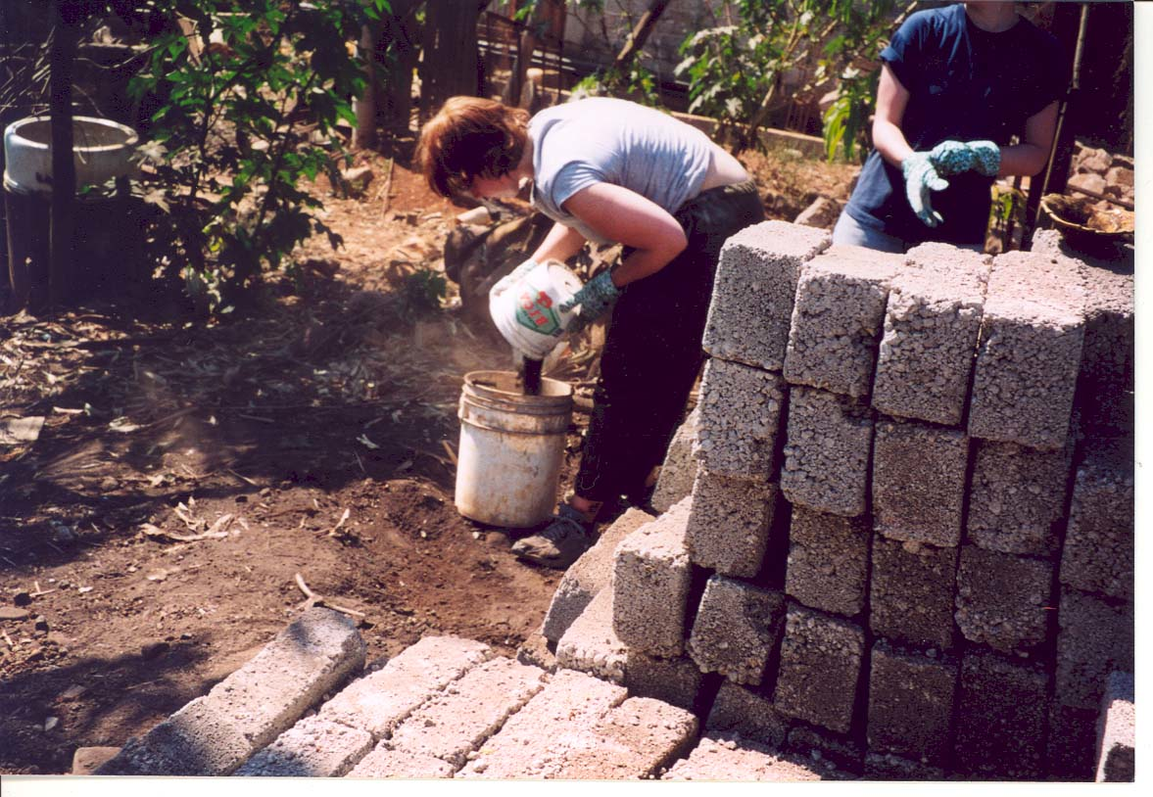
International Trips
Where have we been?
Ishinomaki, Japan
Las Varas, Mexico
Guayaquil, Ecuador
Spring Break Build Trip to
Las Varas, Mexico

Slide 7
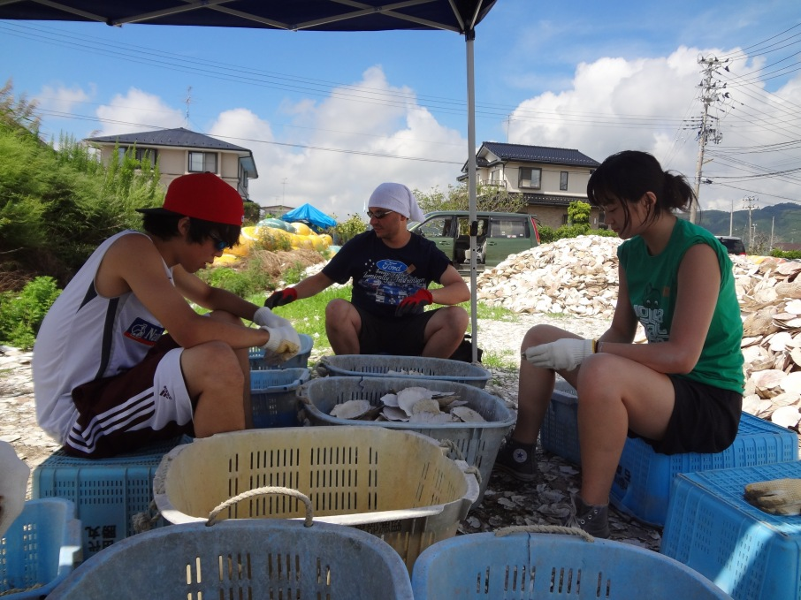
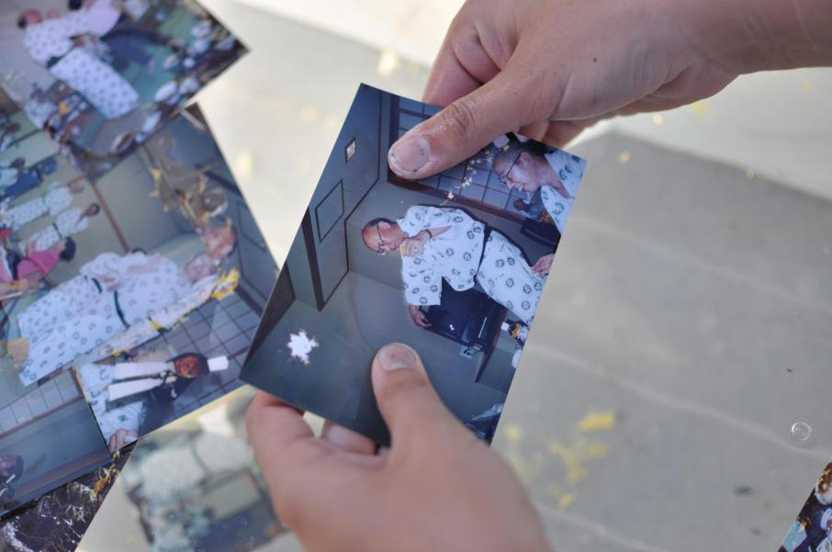
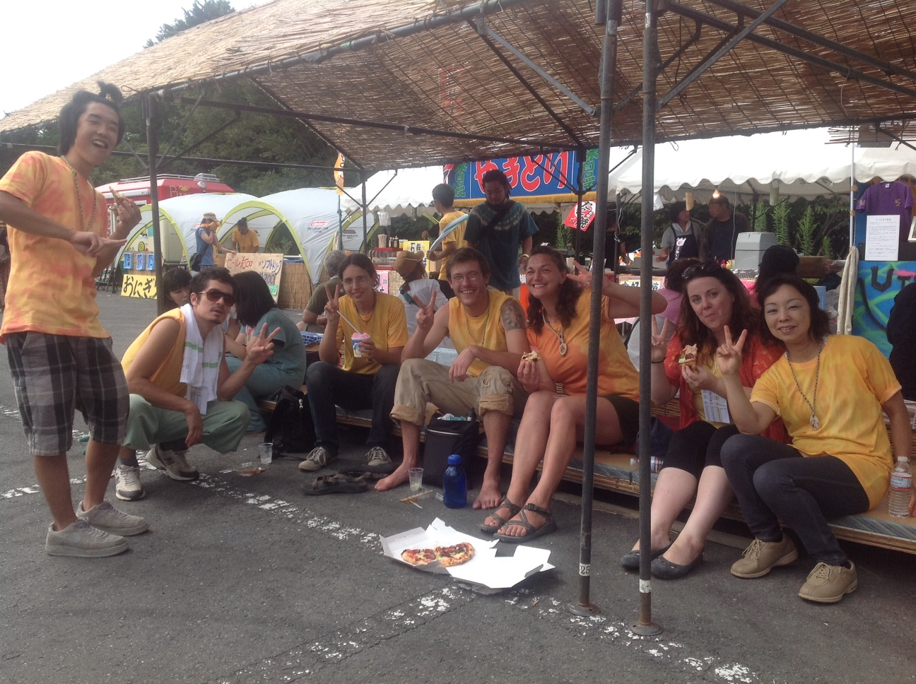
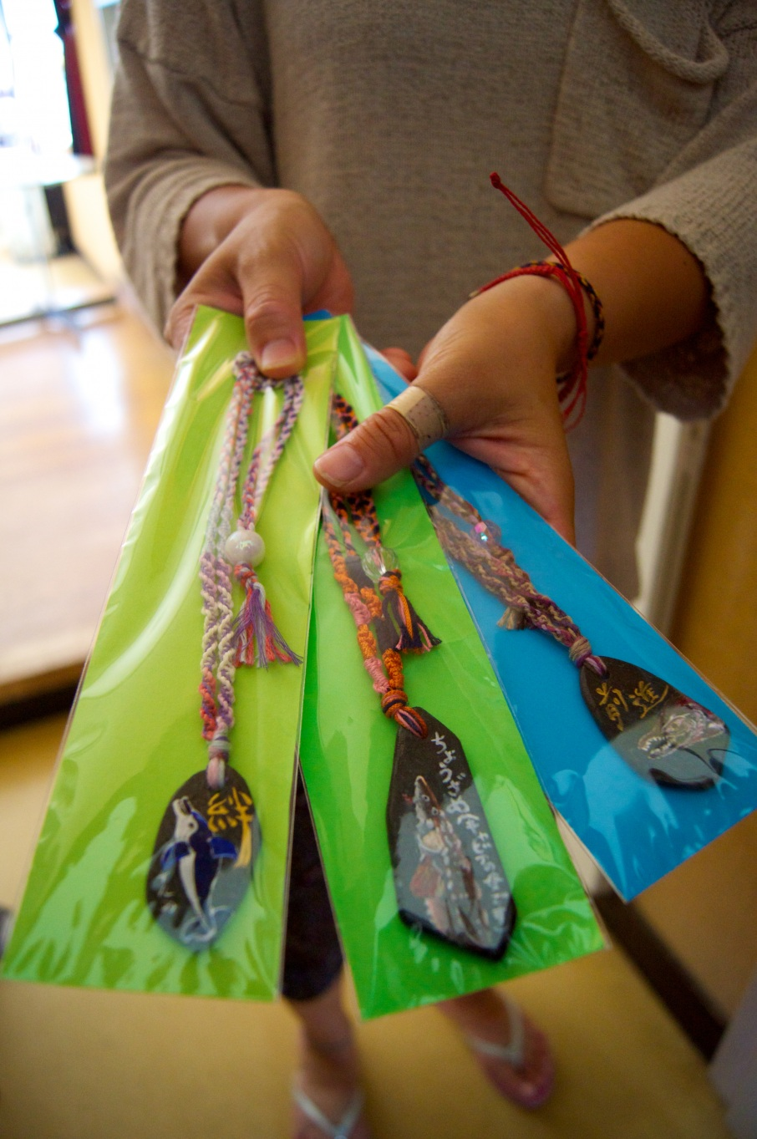
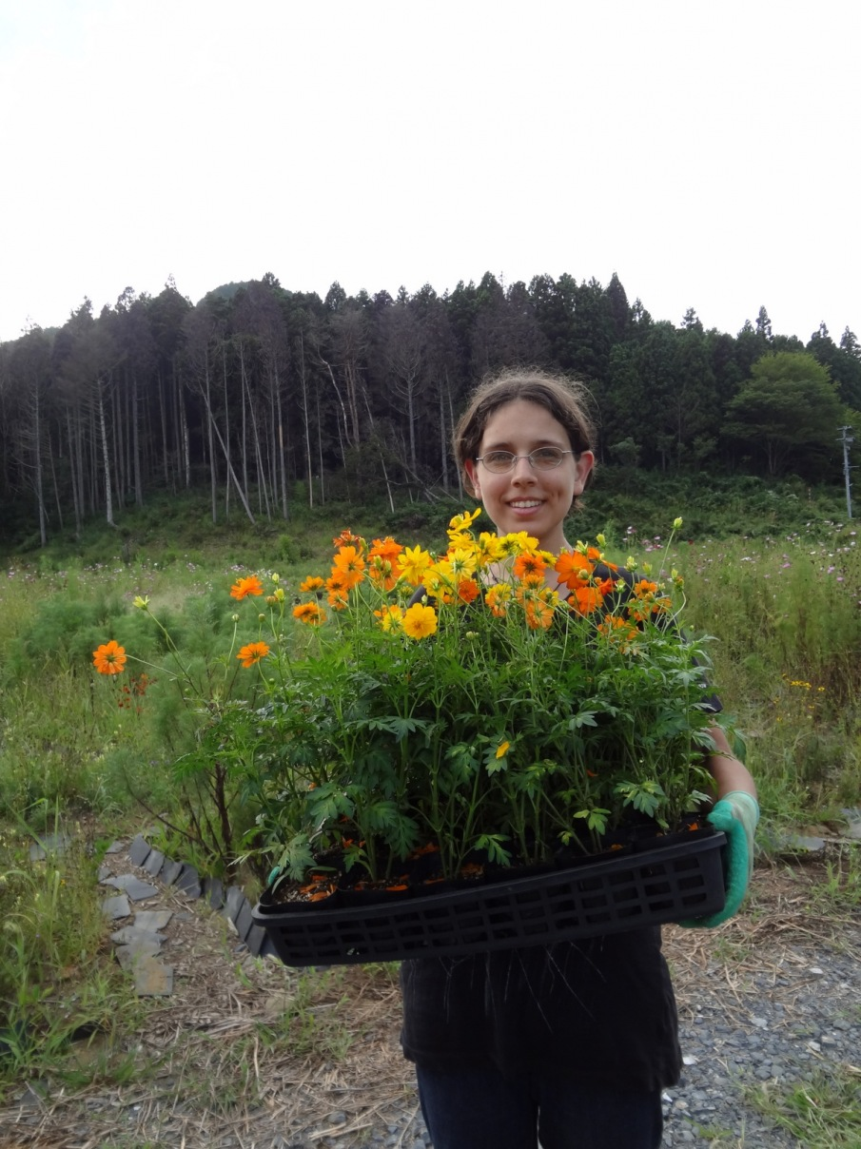
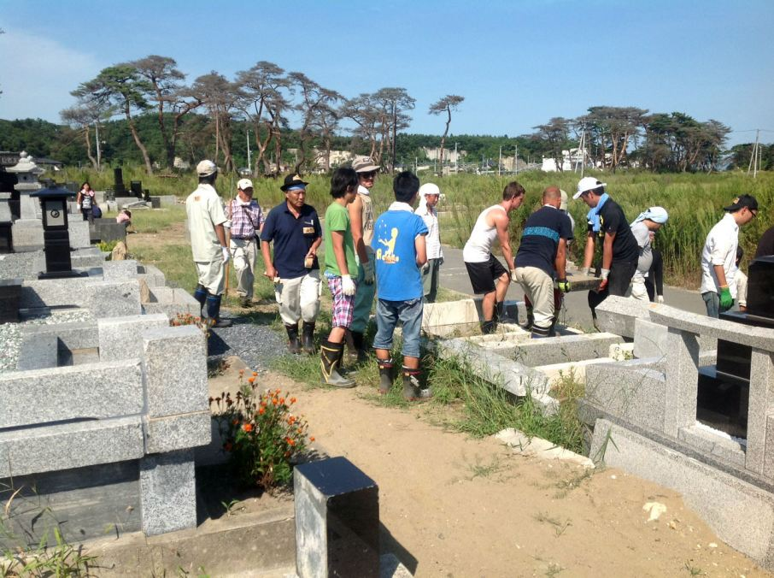
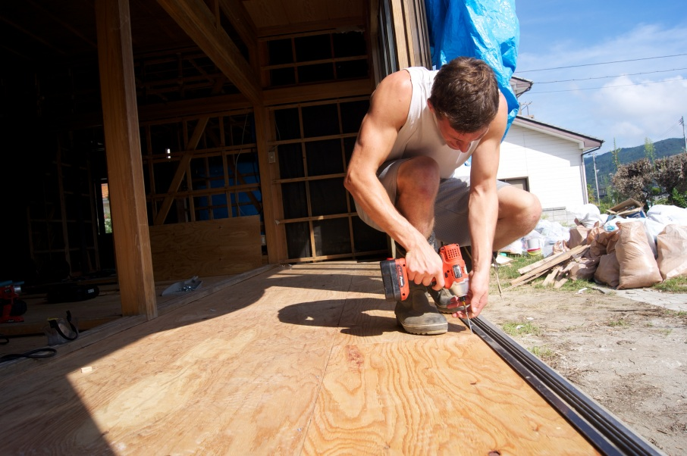

Slide 8
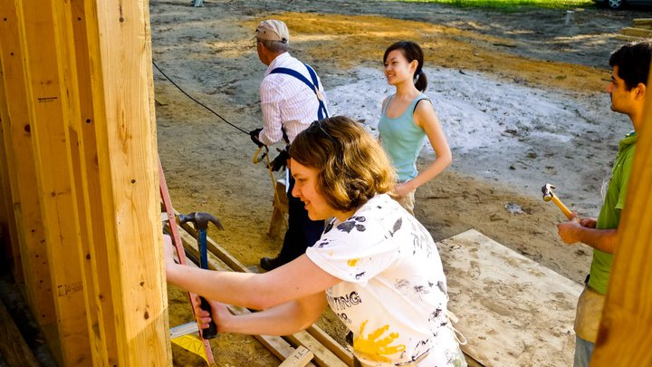
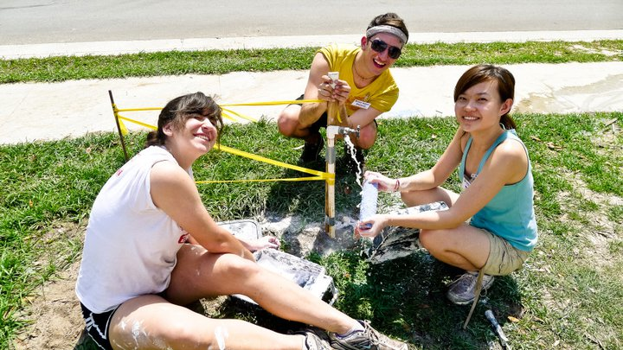
Why Go on a Build Trip?
Support a Good Cause!
Gain Team-Building Experience!
Travel and Network with members involved with community service/non-profit efforts!
Spring Break Build Trip to Dade City, FL (2011)

Slide 9
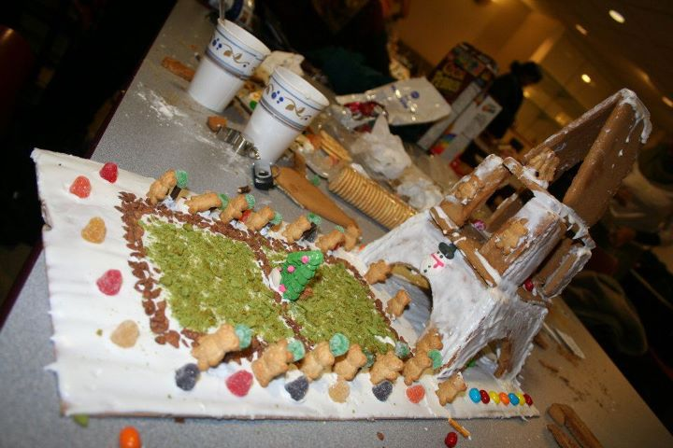
What else do we do?
We hold speaker events to address housing/development issues!
Most Recent: Jeff Leslie’s lecture on Mixed Income Housing Strategies in Chicago
We hold weekly bake sales during Chicago Presents concerts!
We hold additional
fundraisers!
Example: Gingerbread
House Decorating
Competition

Slide 10
How can I get involved?
Sign up for our listhost! Search Uchabitat at lists.uchicago.edu
Any other questions?
Our contact information can be found on our website at habitat.uchicago.edu

